Slide 1
3D Scanning and Spatial Learning Multi-view 4D Volumetric Fusion
Marcel Bruckner, Kevin Bein, Moiz Sajid

Slide 2
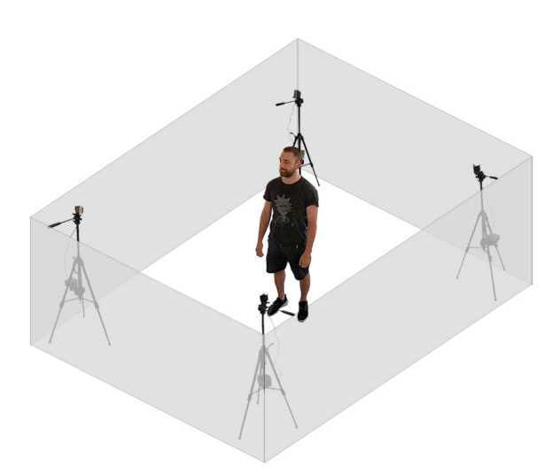
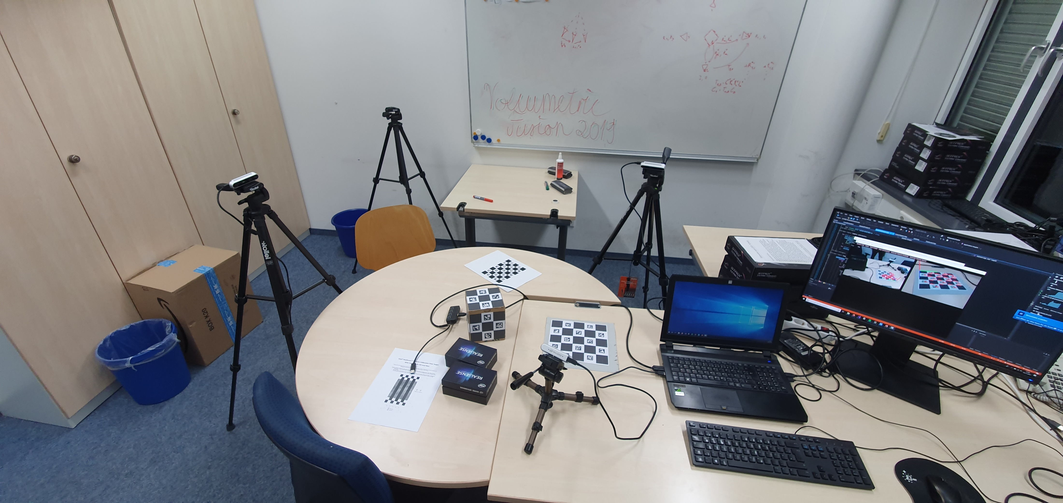
Multi-view 4D Volumetric Capture Setup

Slide 3
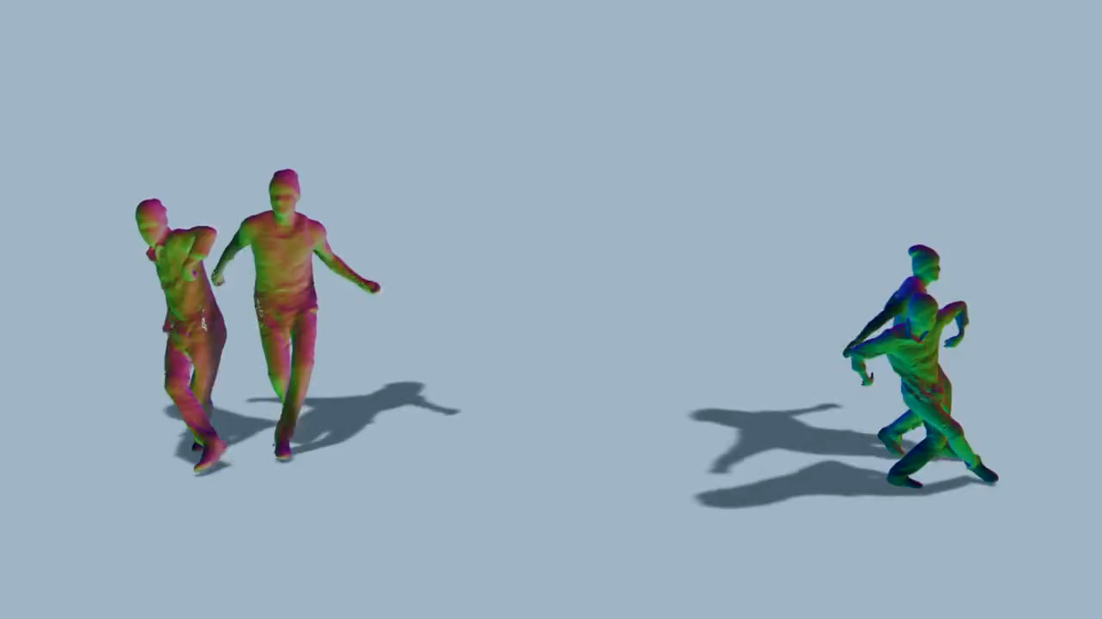
Introduction

Slide 4
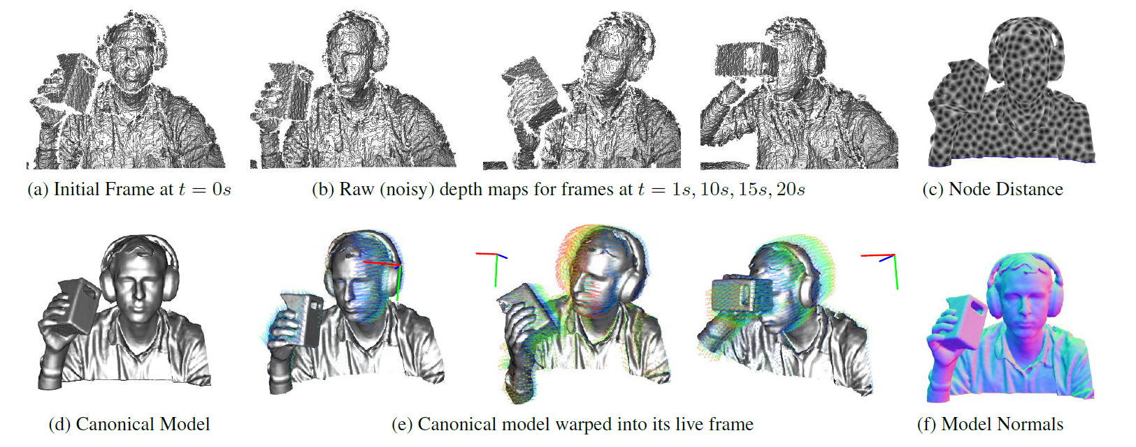
General Overview [Newcombe et al.]

Slide 5
Project Milestones
Camera setup
10.2019
Preprocessing
10.2019
Volumetric Fusion and Blending
12.2019
Rigid alignment
End 11.2019
Optimization
01.2020
Non-rigid Tracking
01.2020
Camera calibration
Most of 11.2019

Slide 6
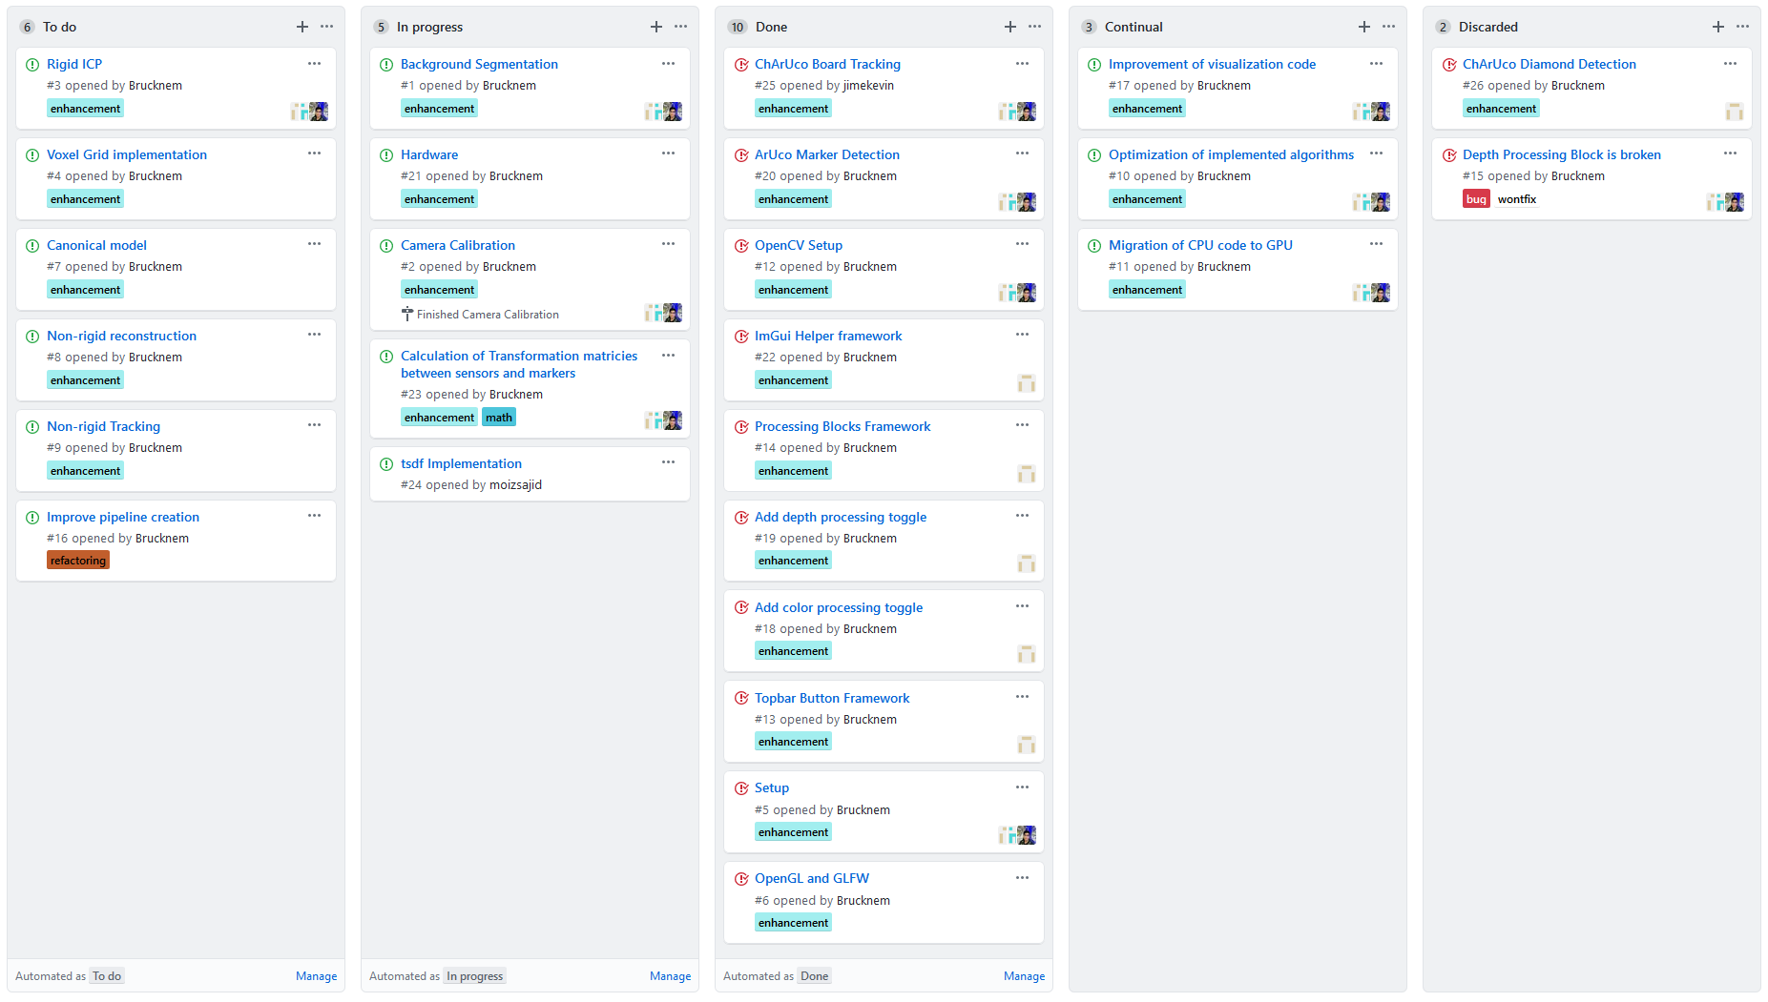
Current state

Slide 7
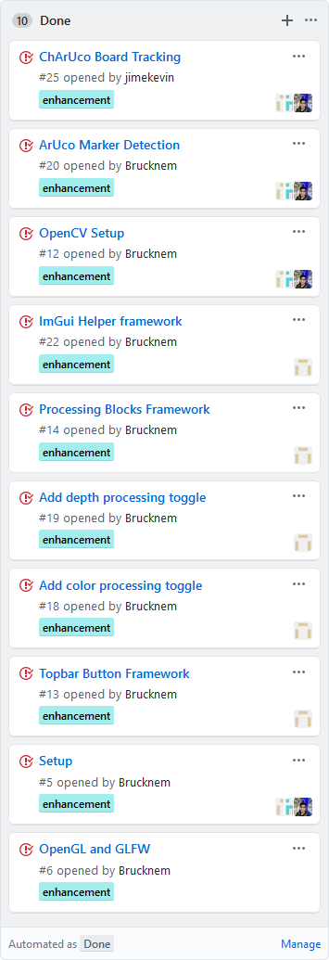
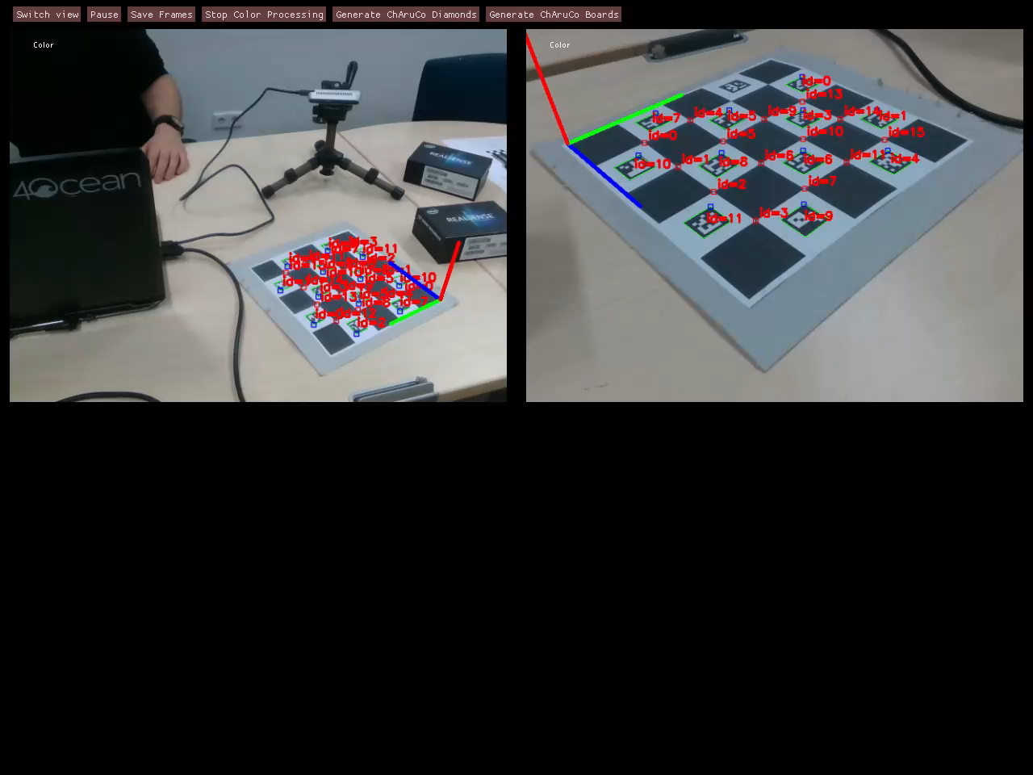
Current state – Done

Slide 8
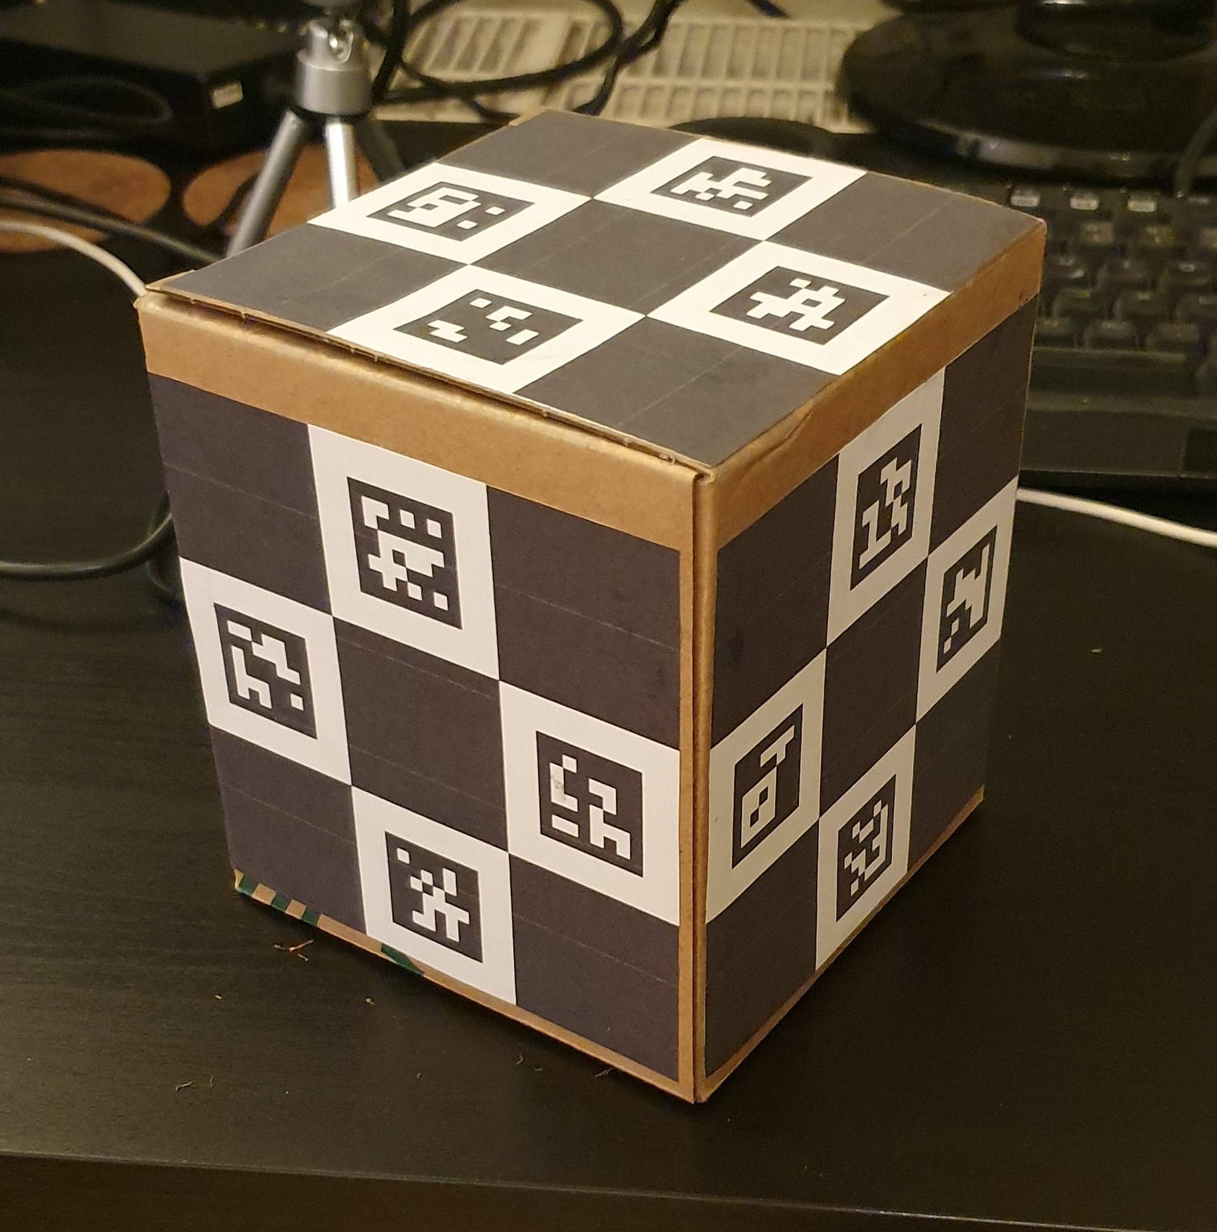
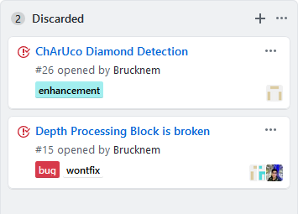
Current state – Discarded

Slide 9
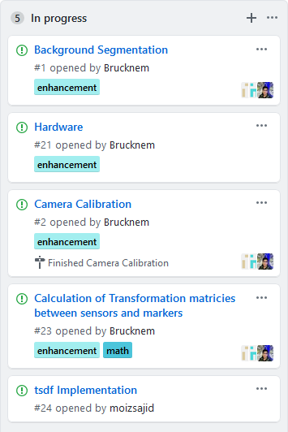

Current state – In progress

Slide 10
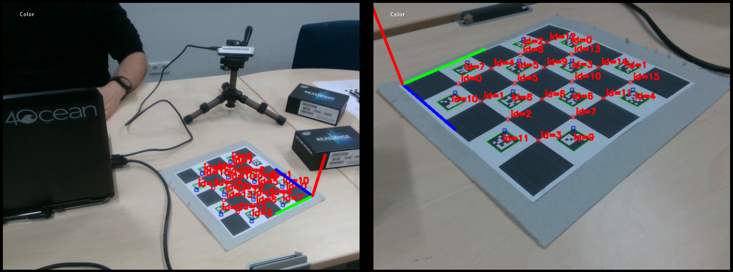
Current state – In progress

Slide 11
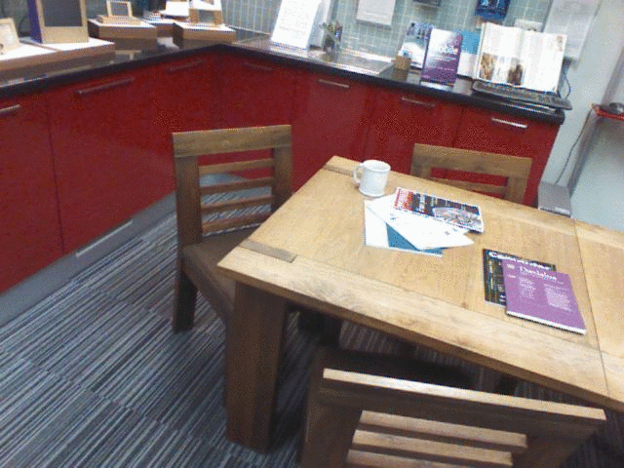
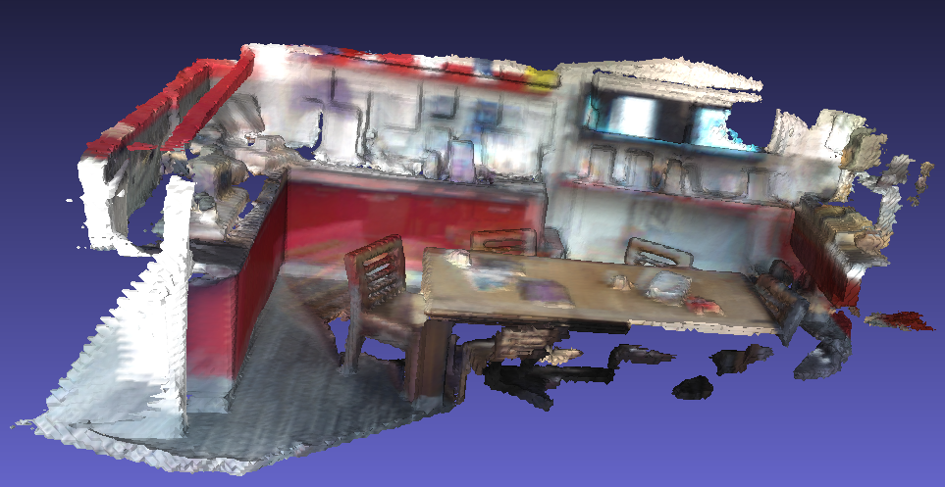
Volumetric Fusion (available on Github)

Slide 12
Project Milestones
Camera setup
10.2019
Preprocessing
10.2019
Volumetric Fusion and Blending
12.2019
Rigid alignment
End 11.2019
Optimization
01.2020
Non-rigid Tracking
01.2020
Camera calibration
Most of 11.2019

Slide 13
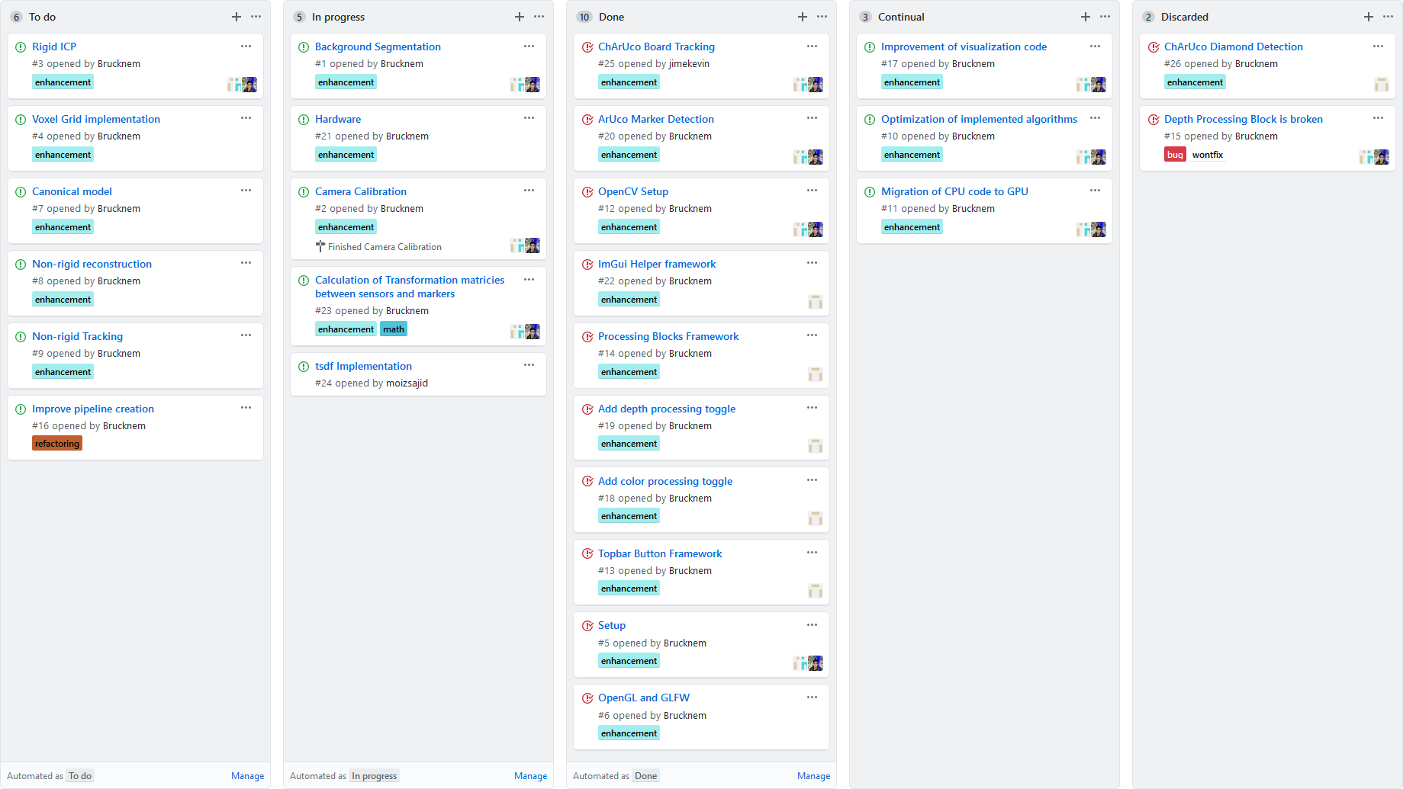
Thank you! Questions? Feedback?

